Slide 1
TensorFlow Certification Yes or No?

Slide 2

TensorFlow Certified Developer
https://www.tensorflow.org/site-assets/downloads/marketing/cert/TF_Certificate_Candidate_Handbook.pdf

Slide 3
1.
Is certification a good idea?

Slide 4
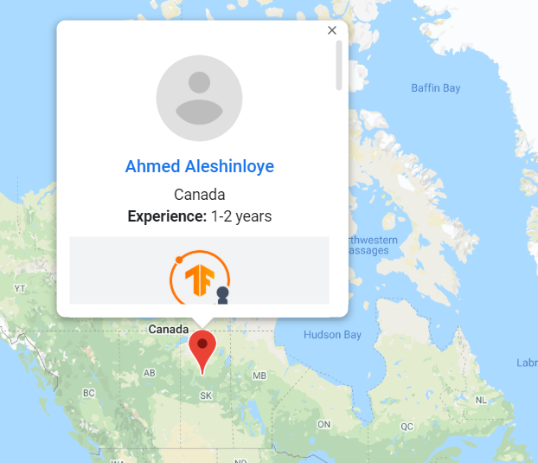
Why Certify your Skills?
Requires learning a core set of skills and knowledge
Establishes a baseline level of knowledge
Gives you confidence in using those skills
Documents your knowledge to others
For the experience

Slide 5

Things to Remember about Certification
It doesn’t guarantee you a job
You need other skills beside a certification
Certification is just the beginning
Tests are stressful and studying can be time consuming
You may not pass your first time

Slide 6

Is Certification right for YOU?
You have spare time…
You are looking to augment your skillset
You can handle stressful tests
You want to showcase your skills
You are looking for a change

Slide 7

Can I just study for the Test and see?
A good approach to test the waters
Still gain knowledge but less experience
Decide if it is right for you
Understand better what additional skills you may lack

Slide 8
2. Okay I want to Certify

Slide 9

but why TensorFlow Developer?
The test is practical and hands-on
It covers a broad base of skills required for a machine learning developer
TensorFlow knowledge can easily transition to other frameworks – PyTorch
Google isn’t making it an easy test for a reason

Slide 10
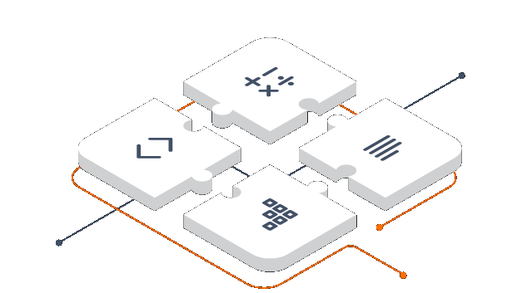
but what skills do I need?
A good base knowledge of Python
Some familiarity with data science
Knowledge in math – statistics, probability, linear algebra and calculus
A basic understanding of machine learning and deep learning

Slide 11

What Else Should I know?
The test is 5 hours and requires you to build 5 working models
It costs $100 USD
If you fail you need to wait 2 weeks,
Fail again wait 2 months
Fail again wait a year
The certification only lasts 3 years

Slide 12
3. Preparing To Study for the Test

Slide 13
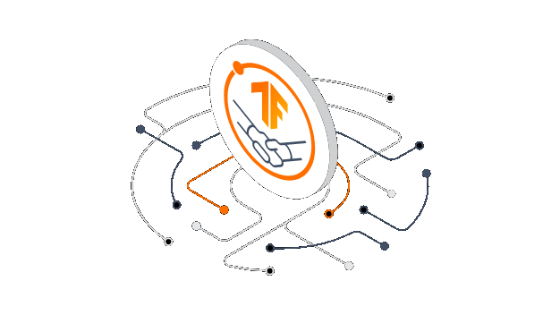
Review Primary Core Skills
Coding Skills – program with Python on/with TensorFlow
Math and stats – review basic math concepts (stats and linear algebra)
ML theory – understand why the models work and how
Build projects – Best experience is doing
Tune hyperparameters!!!

Slide 14
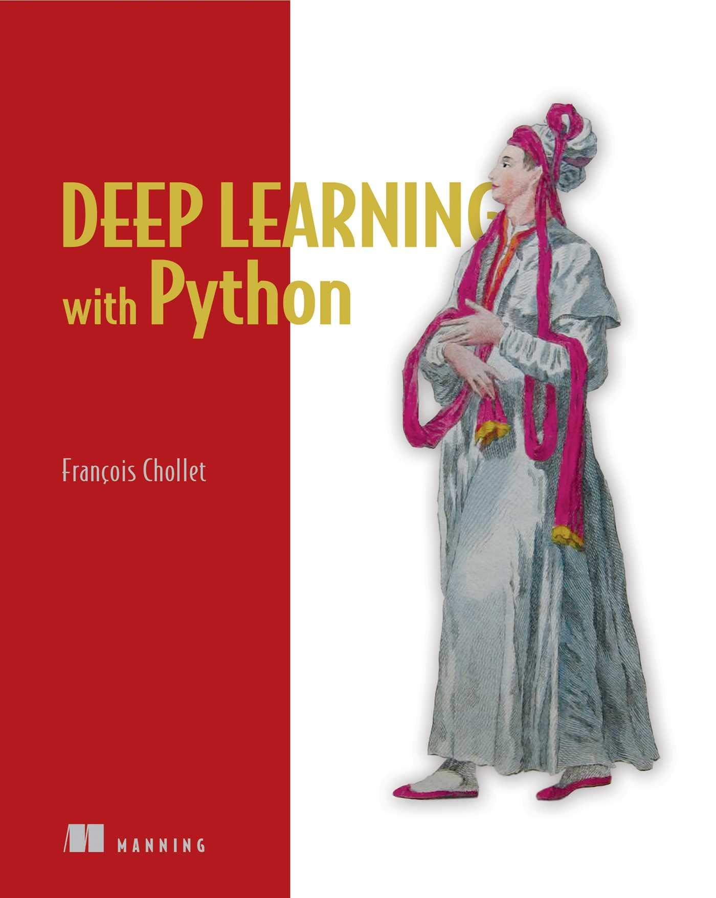
Review Background Materials (Videos, Courses & Books)
Deep learning by 3blue1brown
Essence of Linear Algebra by 3blue1brown
Essence of Calculus by 3blue1brown
Google Developers Machine Learning Crash Course
https://developers.google.com/machine-learning/crash-course
Deep Learning with Python (Francois Chollet)

Slide 15

Be Aware of…
Losing focus – if your plan is to take the test…
Set attainable goals
Expensive courses – there are plenty of good free resources
Feeling overwhelmed – work at your own pace
Taking too long – 6 months or less

Slide 16
4. Study for the Test

Slide 17
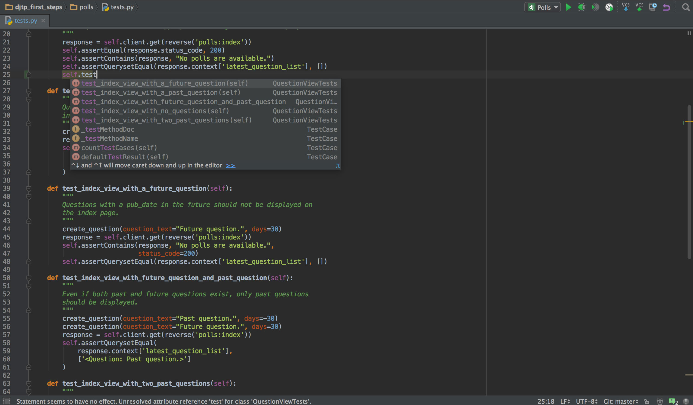
Coding Skills
Code in PyCharm
Learn Python libraries
numpy
matplotlib
PIL (pillow)
pandas
Explore TF datasets

Slide 18
Build and train NN with TF 2.0
1.
Use TensorFlow 2.x.
Build, compile and train machine learning (ML) models using TensorFlow.
Preprocess data to get it ready for use in a model.
Use models to predict results.
Build sequential models with multiple layers.
Build and train models for binary classification.
Build and train models for multi-class categorization.
Plot loss and accuracy of a trained model.
Identify strategies to prevent overfitting, including augmentation and dropout.
Use pretrained models (transfer learning).
Extract features from pre-trained models.
Ensure that inputs to a model are in the correct shape.
Ensure that you can match test data to the input shape of a neural network.
Ensure you can match output data of a neural network to specified input shape for test data.
Understand batch loading of data.
Use callbacks to trigger the end of training cycles.
Use datasets from different sources.
Use datasets in different formats, including json and csv.
Use datasets from tf.data.datasets

Slide 19
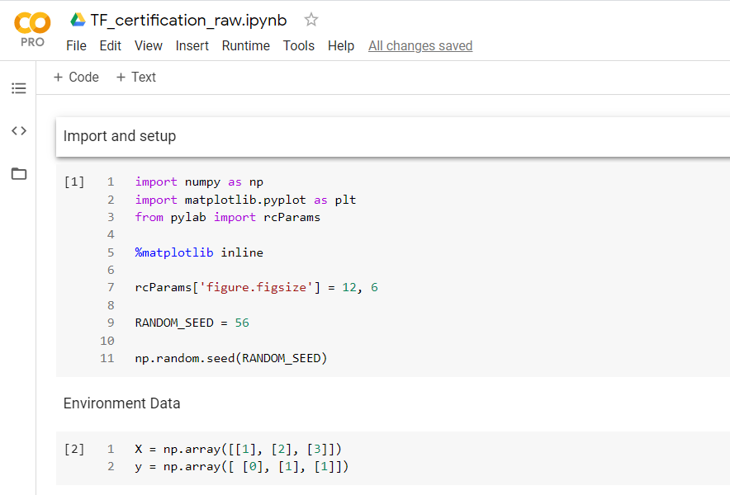
TF_certification_raw.ipynb
covers activation functions
backpropagation
internals of neural networks
likely won’t need to write any of the test but useful to understand

Slide 20
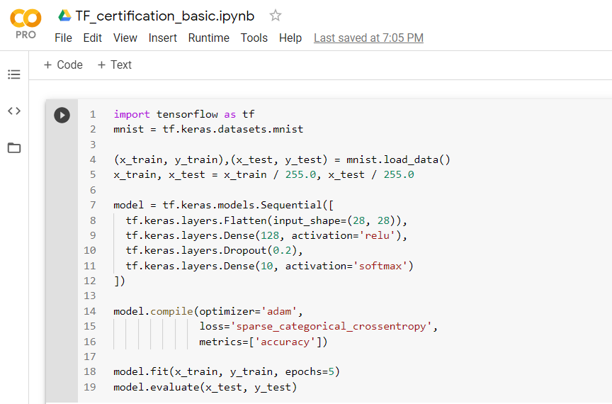
TF_certification_basic.ipynb
load data from datasets
normalize data
build sequential model
build model for classification
compile and run a model

Slide 21
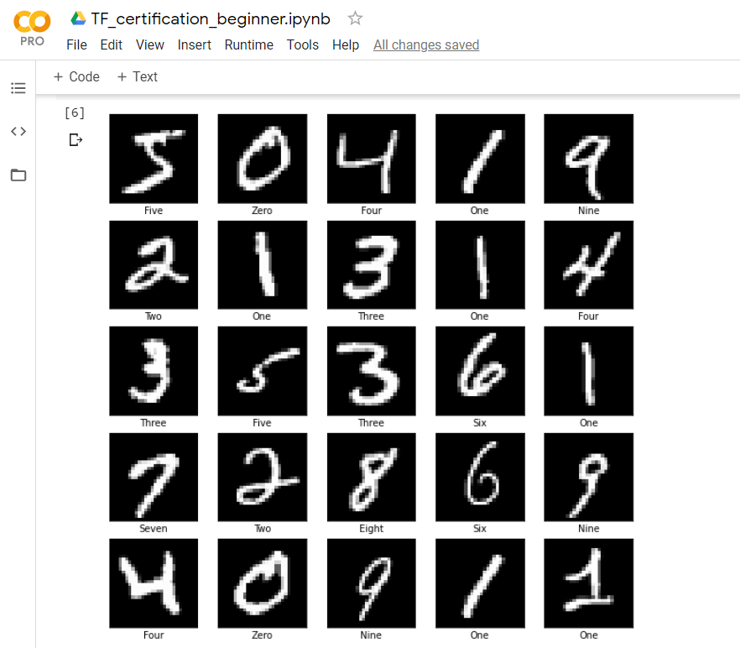
TF_certification_beginner.ipynb
understand how softmax and multi-class classifiers work
plot model output

Slide 22
Image Classification
2.
Define Convolutional neural networks with Conv2D and pooling layers.
Build and train models to process real-world image datasets.
Understand how to use convolutions to improve your neural network.
Use real-world images in different shapes and sizes..
Use image augmentation to prevent overfitting.
Use ImageDataGenerator.
Understand how ImageDataGenerator labels images based on the directory structure

Slide 23
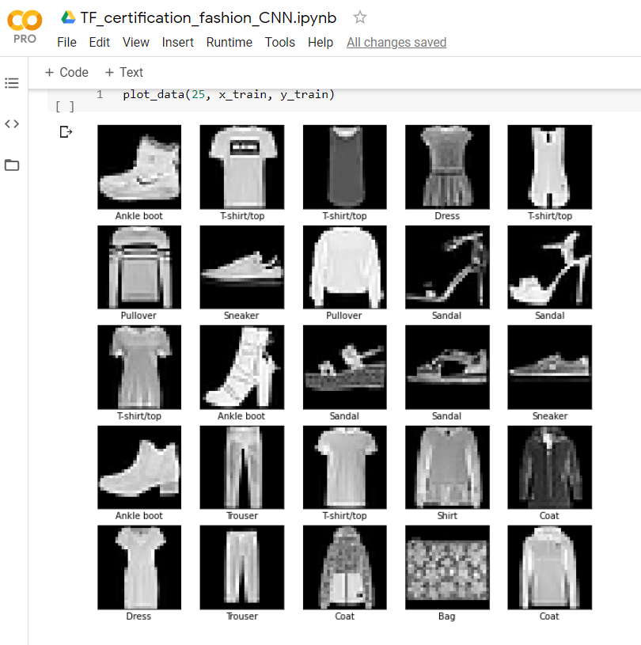
TF_certification_fashion_CNN.ipynb
Convolutional layers and pooling
plot model output

Slide 24
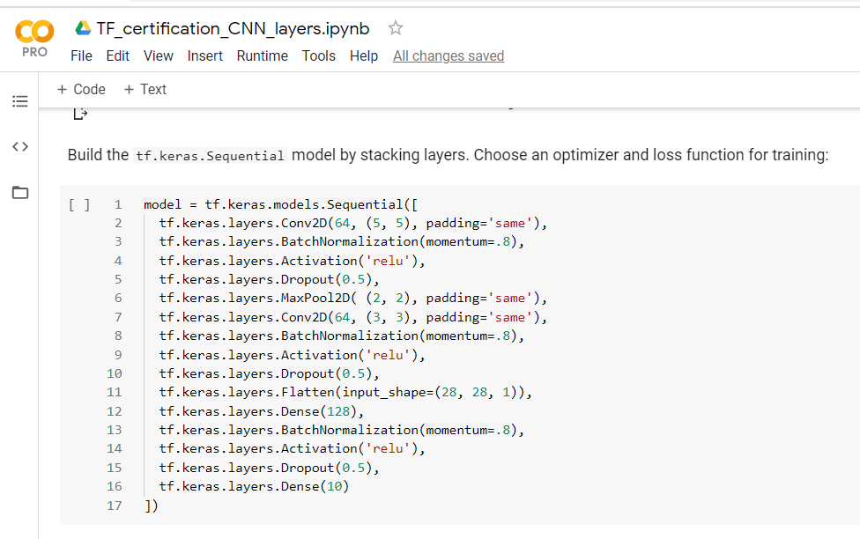
TF_certification_CNN_Layers.ipynb
over and under fitting
Dropout layers
BatchNormalization layers

Slide 25
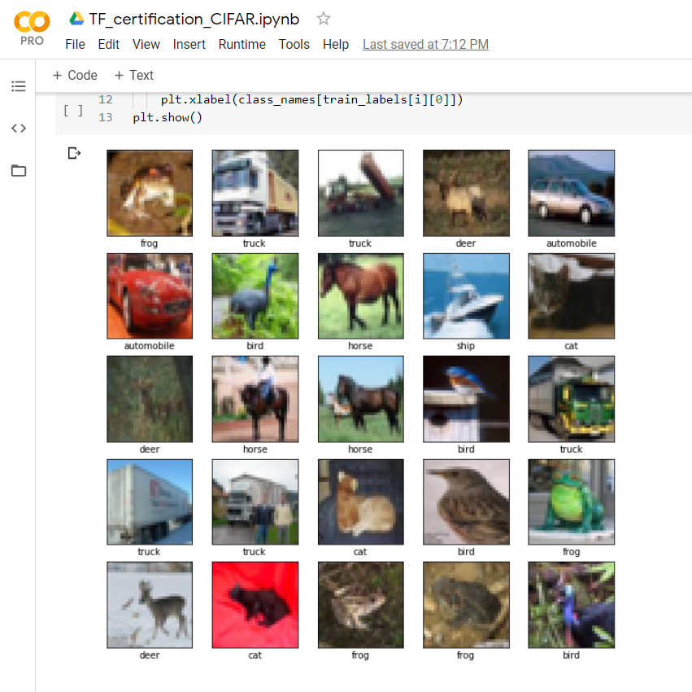
TF_certification_CIFAR.ipynb
multi-channel image data
understand how to manipulate CNN
multi-class classification with image data
plot train and test accuracy

Slide 26
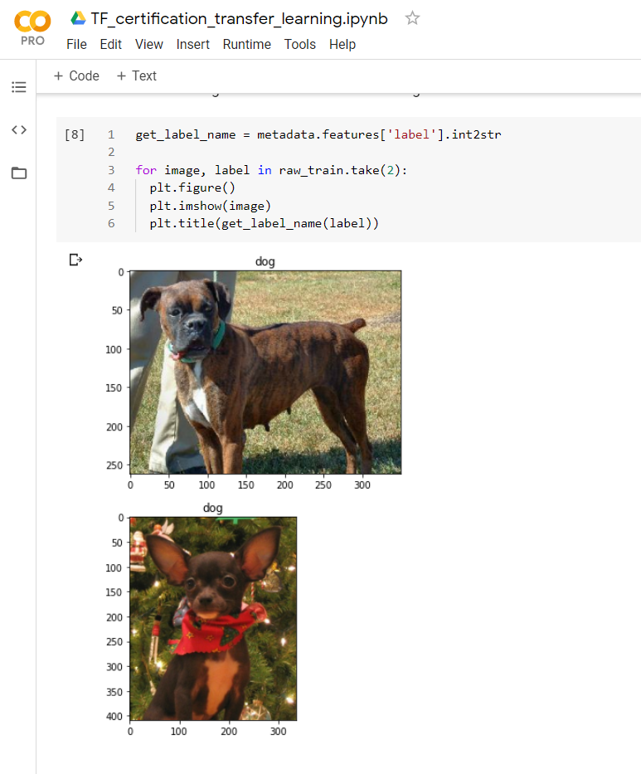
TF_certification_transfer_learning.ipynb
Transfer learning
reshape real world images
working with image data
plot model output
batch loading data

Slide 27
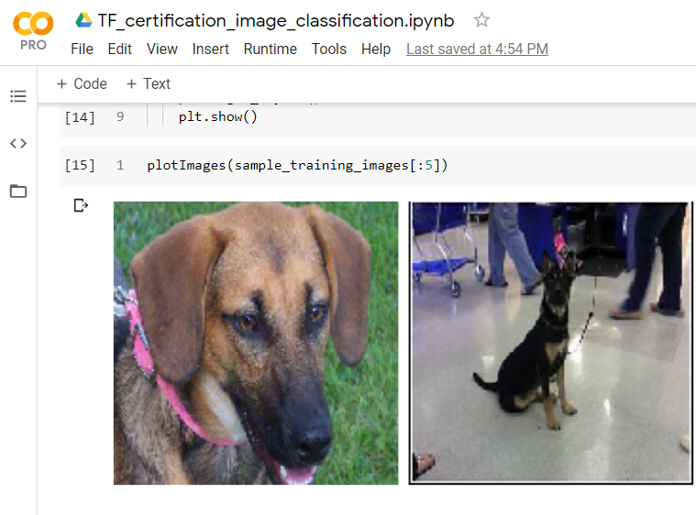
TF_certification_image_classification.ipynb
Build an input pipeline, image generators
overfitting with image data
data augmentation and dropout
batch loading data

Slide 28
Natural Language Processing
3.
Build natural language processing systems using TensorFlow.
Prepare text to use in TensorFlow models.
Build models that identify the category of a piece of text using binary categorization
Build models that identify the category of a piece of text using multi-class categorization
Use word embeddings in your TensorFlow model.
Use LSTMs in your model to classify text for either binary or multi-class categorization.
Add RNN and GRU layers to your model.
Use RNNS, LSTMs, GRUs and CNNs in models that work with text.
Train LSTMs on existing text to generate text (such as songs and poetry)

Slide 29
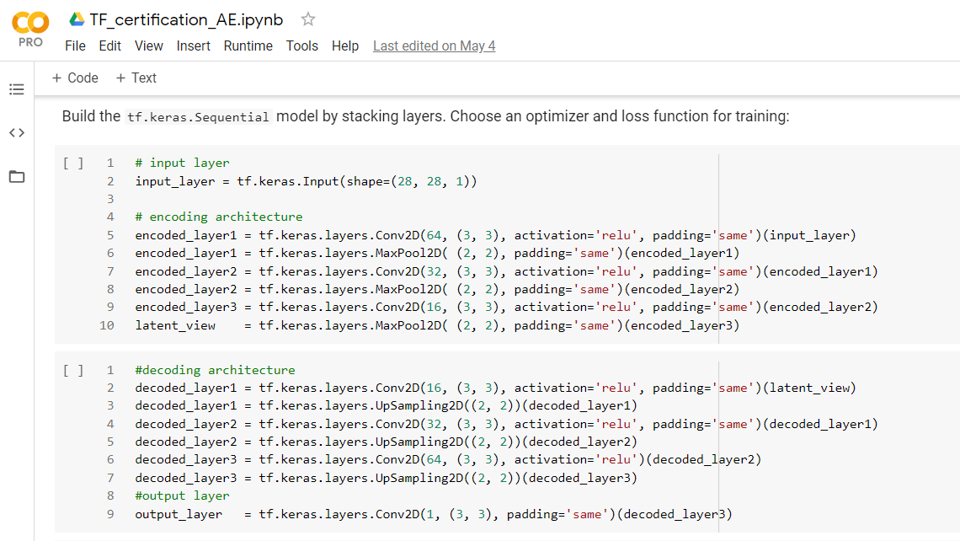
TF_certification_AE.ipynb
autoencoders basis for sequence to sequence learning and embeddings

Slide 30
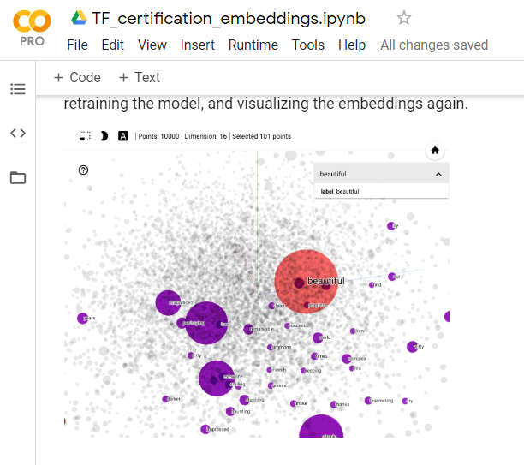
TF_certification_embeddings.ipynb
word embeddings are essential for NLP

Slide 31
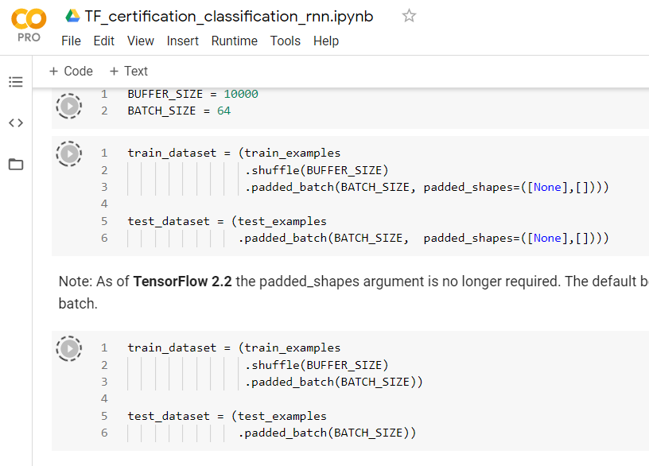
TF_certification_classification_rnn.ipynb
basis for NLP text classification and generation
preparing text (tokenization and stemming)
use RNN layers like RNN, LSTM or GRU
sentiment analysis, good or bad (binary classification)

Slide 32
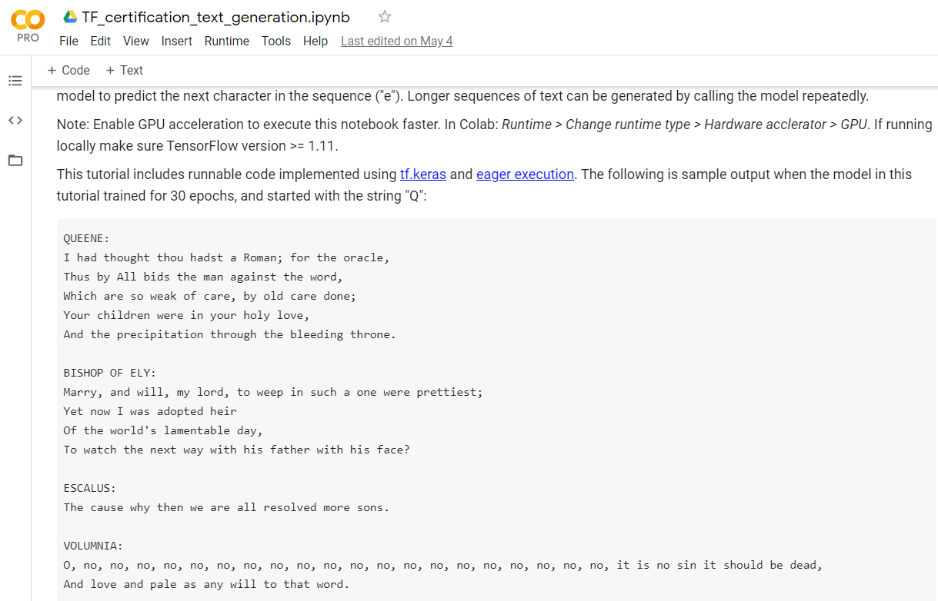
TF_certification_text_generation.ipynb
text generation from a model
use RNN layers like RNN, LSTM or GRU
checkpoint models and restoring
advanced training with gradient tapes

Slide 33
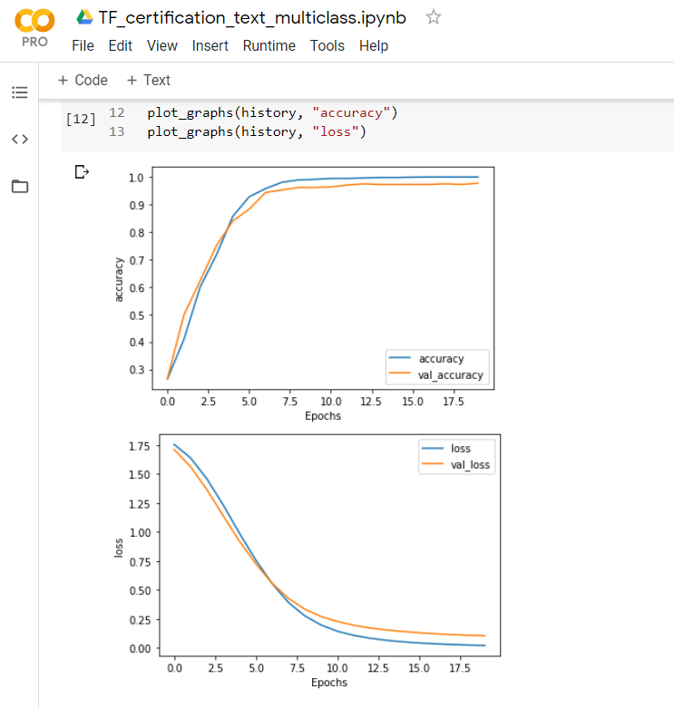
TF_certification_text_multiclass.ipynb
multiclass text classification
review on tokenizers and sequence padding
uses only embeddings layer

Slide 34
Time Series Prediction
4.
Train, tune and use time series, sequence and prediction models.
Prepare data for time series learning.
Understand Mean Average Error (MAE) and how it can be used to evaluate accuracy of sequence models.
Use RNNs and CNNs for time series, sequence and forecasting models.
Identify when to use trailing versus centered windows
Use TensorFlow for forecasting.
Prepare features and labels.
Identify and compensate for sequence bias.
Adjust the learning rate dynamically in time series, sequence and prediction models

Slide 35
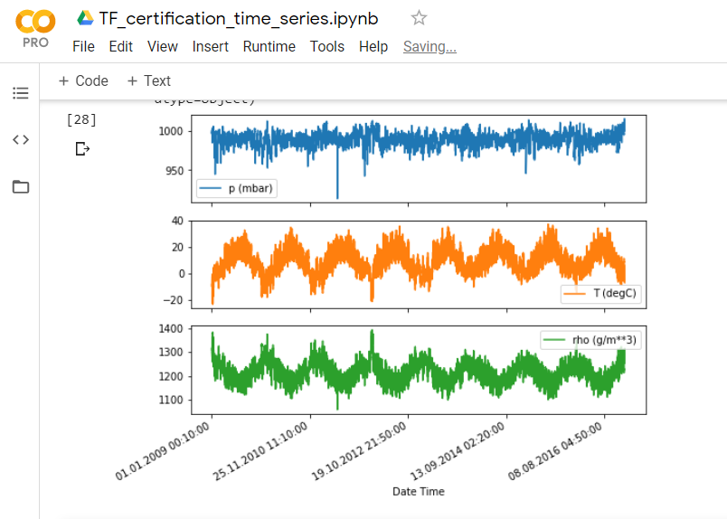
TF_certification_time_series.ipynb
prepare time series data
plot time series data
uses only embeddings layer
understand windowing of data
prepare features and labels
use RNN to model data
multivariate time series data

Slide 36
Taking the TEST - Tips
tackle slower models first NLP – models with multiple RNN layers
use consistent language and be sure to write Pythonic code
run multiple models concurrently, if possible
make sure and always use test/validation data
watch for over or under fitting
beware of tricks or gotchas, certification exams are notorious
read each question twice before starting, then plan an attack based on how long each model may take to run
Watch hyperparameters but don’t get hung up them – if train/test loss/accuracy good consider the model good in most cases

Slide 37
5. Need Help Studying?

Slide 38
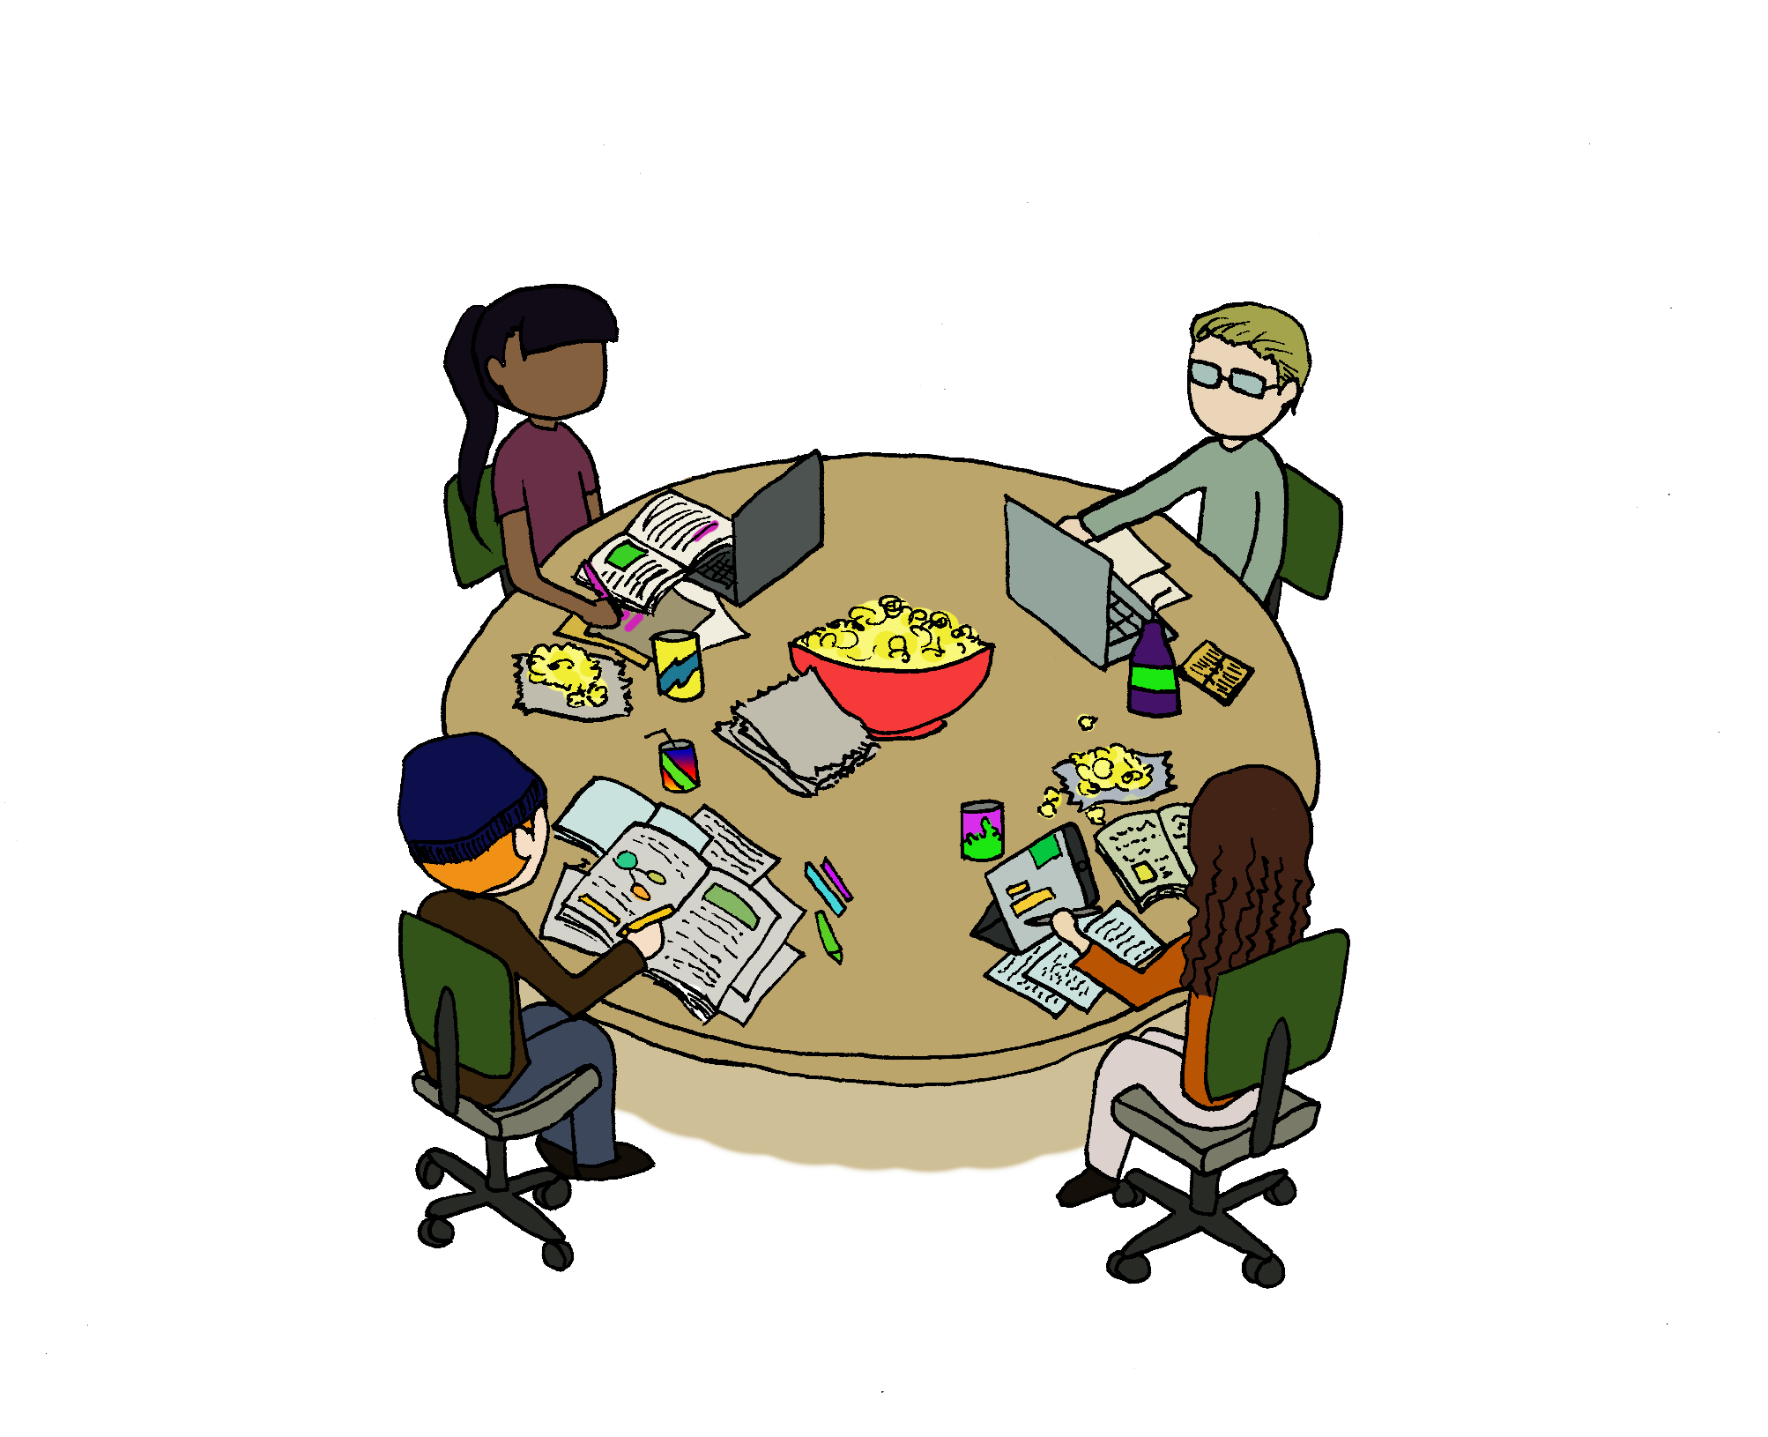
Forming a Study Group?
Form your own group – helping or getting help from people works both ways
I am looking to form an ongoing group
contact me if interested
cxbxmxcx@gmail.com

Slide 39
thanks!
Any questions?
You can find me at
cxbxmxcx@gmail.com
https://www.linkedin.com/in/micheal-lanham-189693123

Slide 40
Quotations are commonly printed as a means of inspiration and to invoke philosophical thoughts from the reader.

Slide 41
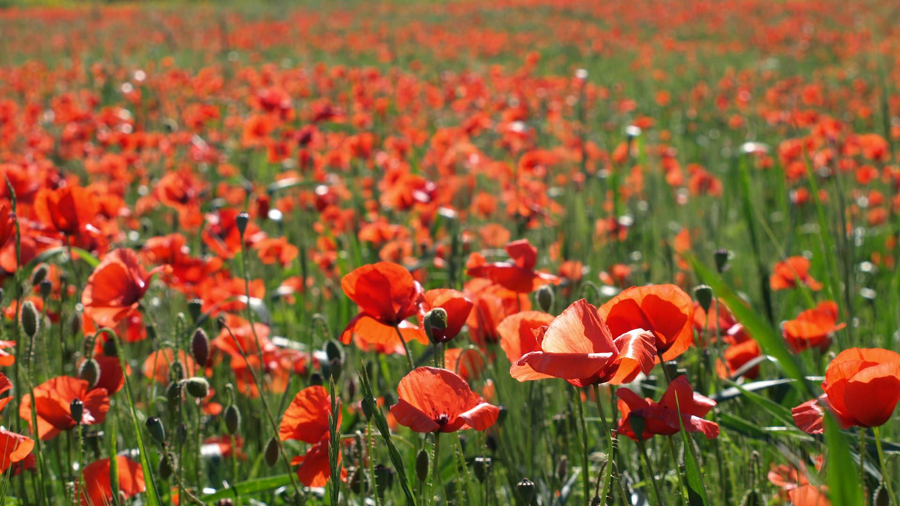
Want big impact?
Use big image.

Slide 42
Use charts to explain your ideas
White
Gray
Black

Slide 43
Maps
our office

Slide 44
89,526,124
Whoa! That’s a big number, aren’t you proud?

Slide 45
89,526,124$
185,244 users
100%
That’s a lot of money
And a lot of users
Total success!

Slide 46
Our process is easy
first
second
last

Slide 47
Let’s review some concepts
Yellow
Is the color of gold, butter and ripe lemons. In the spectrum of visible light, yellow is found between green and orange.
Blue
Is the colour of the clear sky and the deep sea. It is located between violet and green on the optical spectrum.
Red
Is the color of blood, and because of this it has historically been associated with sacrifice, danger and courage.
Yellow
Is the color of gold, butter and ripe lemons. In the spectrum of visible light, yellow is found between green and orange.
Blue
Is the colour of the clear sky and the deep sea. It is located between violet and green on the optical spectrum.
Red
Is the color of blood, and because of this it has historically been associated with sacrifice, danger and courage.

Slide 48
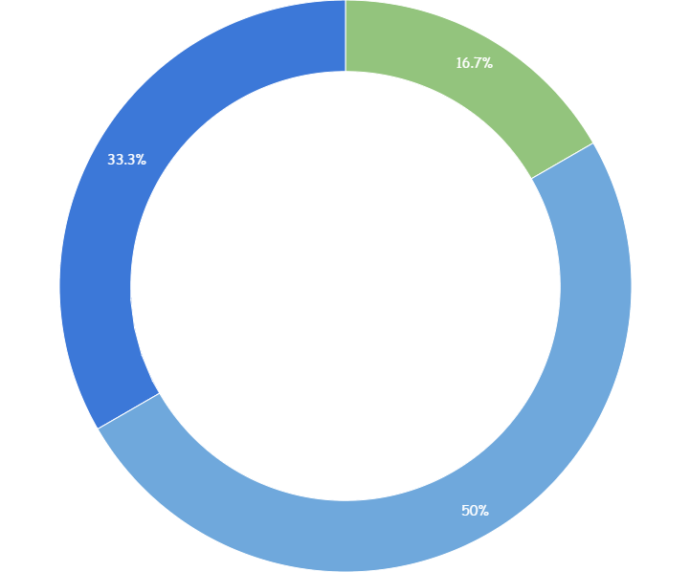
You can copy&paste graphs from Google Sheets

Slide 49
Place your screenshot here
Android project
Show and explain your web, app or software projects using these gadget templates.

Slide 50
Place your screenshot here
iPhone project
Show and explain your web, app or software projects using these gadget templates.

Slide 51
Place your screenshot here
Tablet project
Show and explain your web, app or software projects using these gadget templates.

Slide 52
Place your screenshot here
Desktop project
Show and explain your web, app or software projects using these gadget templates.

Slide 53
thanks!
Any questions?
You can find me at
@username
user@mailme

Slide 54
Credits
Special thanks to all the people who made and released these awesome resources for free:
Presentation template by SlidesCarnival
Photographs by Unsplash

Slide 55
Presentation design
This presentation uses the following typographies:
Titles: Walter Turncoat
Body copy: Sniglet
You can download the fonts on these pages:
https://www.fontsquirrel.com/fonts/walter-turncoat
https://www.fontsquirrel.com/fonts/sniglet
You don’t need to keep this slide in your presentation. It’s only here to serve you as a design guide if you need to create new slides or download the fonts to edit the presentation in PowerPoint®

Slide 56
Extra graphics

Slide 57
SlidesCarnival icons are editable shapes.
This means that you can:
Resize them without losing quality.
Change fill color and opacity.
Isn’t that nice? :)
Examples:

Slide 58
😉
Now you can use any emoji as an icon!
And of course it resizes without losing quality and you can change the color.
How? Follow Google instructions https://twitter.com/googledocs/status/730087240156643328
✋👆👉👍👤👦👧👨👩👪💃🏃💑❤😂😉😋😒😭👶😸🐟🍒🍔💣📌📖🔨🎃🎈🎨🏈🏰🌏🔌🔑 and many more...

Slide 59

Free templates for all your presentation needs
For PowerPoint and Google Slides
100% free for personal or commercial use
Ready to use, professional and customizable
Blow your audience away with attractive visuals

